Slide 1




Slide 2
The Comparison of Income Level Prediction Models
Qiudong Deng

Slide 3

Project Goal
This project aims to select the best model from logistic regression, random forest , support vector machine, decision tree and gradient boosting models to predict if the income level of an individual in the US is greater than or less than $50,000 based on the information available for the individual from the census data.
Area under the curve (AUC) of receiver operating characteristic (ROC)
and confusion matrix as selection criterions
The dependent (target) variable for this project is binary (income level>50K or <=50K).

Slide 4

Data
This dataset named “Census Income Data Set” can be downloaded from the public website (http://archive.ics.uci.edu/ml/datasets/Census+Income).
This dataset has 48,842 instances and 14 independent variables that were extracted from the 1994 census data.

Slide 5
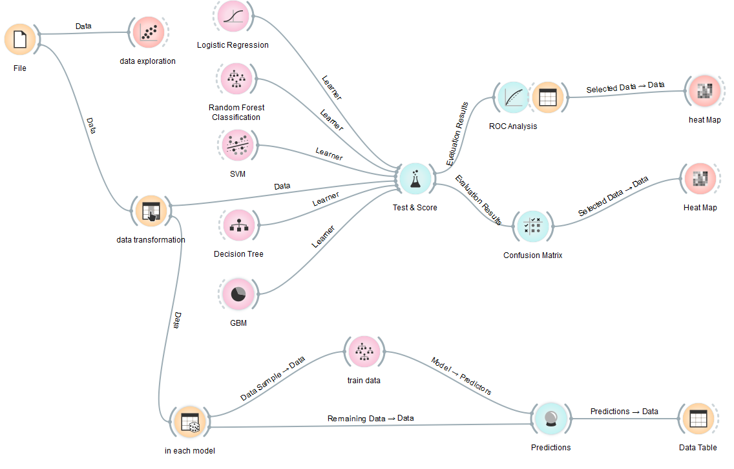
Workflow

Slide 6
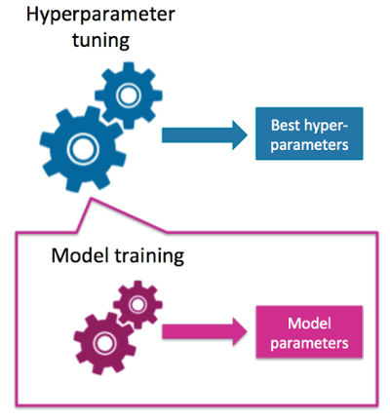
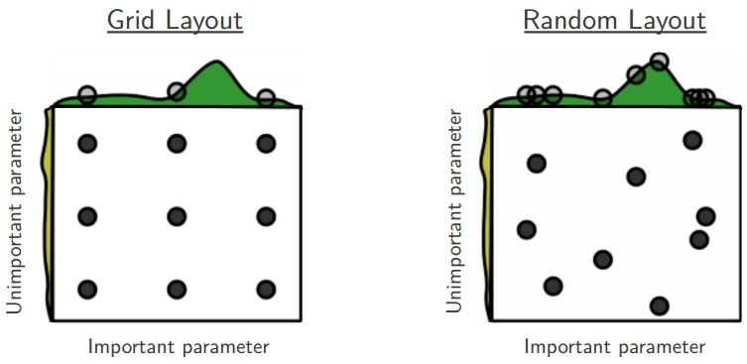
Two Layouts for Hyper-parameter Optimization in Python Scikit-learn Library

Slide 7


Random Forest

Slide 8
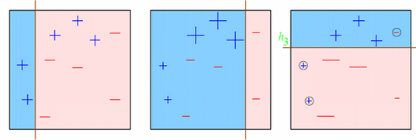
Gradient Boosting Machines (GBM)

Slide 9
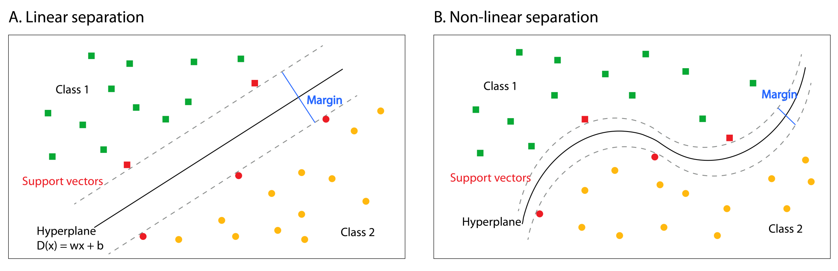
Support Vector Machines (SVM)

Slide 10



Confusion Matrix
=>Sensitivity
=> Weighted average of the precision and recall
The higher the better!

Slide 11
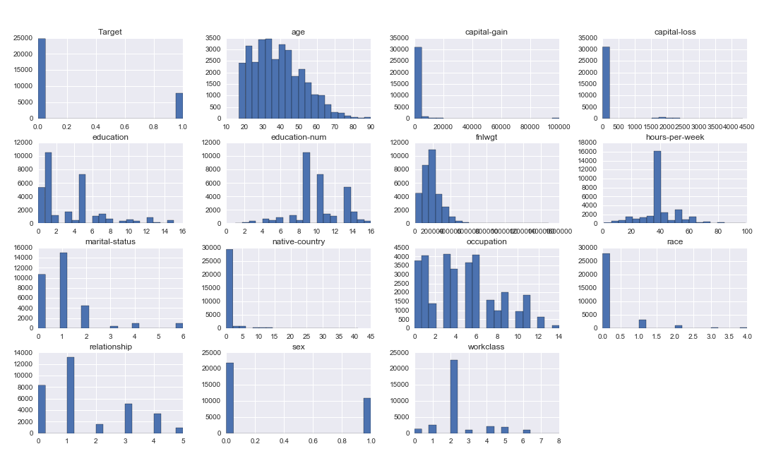
Distribution of Variables

Slide 12
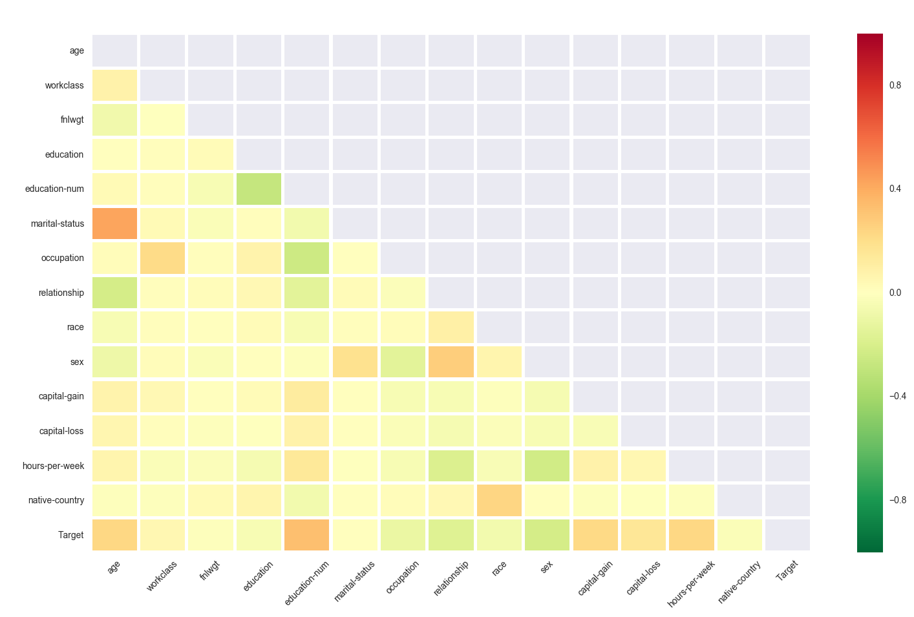

Correlation Matrix

Slide 13
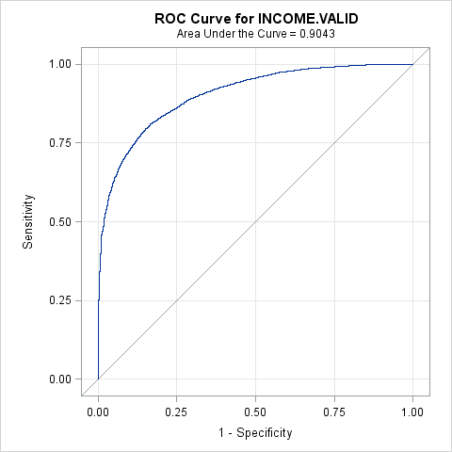
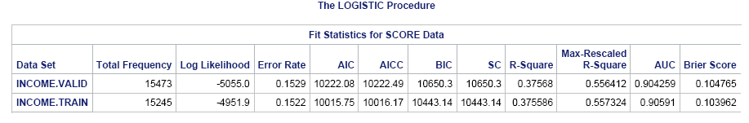
ROC Curve for Logistic Regression

Slide 14
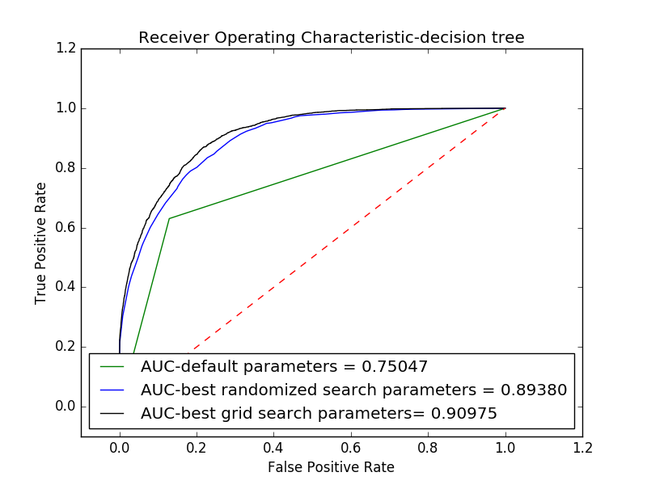

AUC Comparisons in Decision Tree

Slide 15
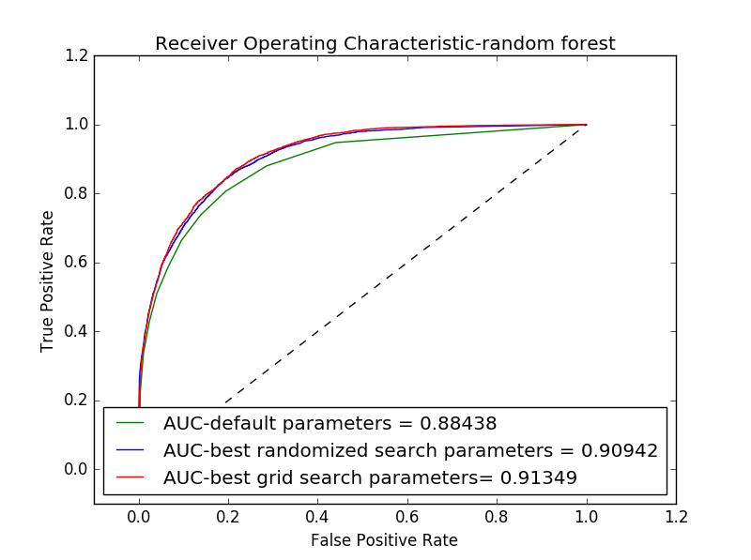
AUC Comparisons in Random Forest

Slide 16
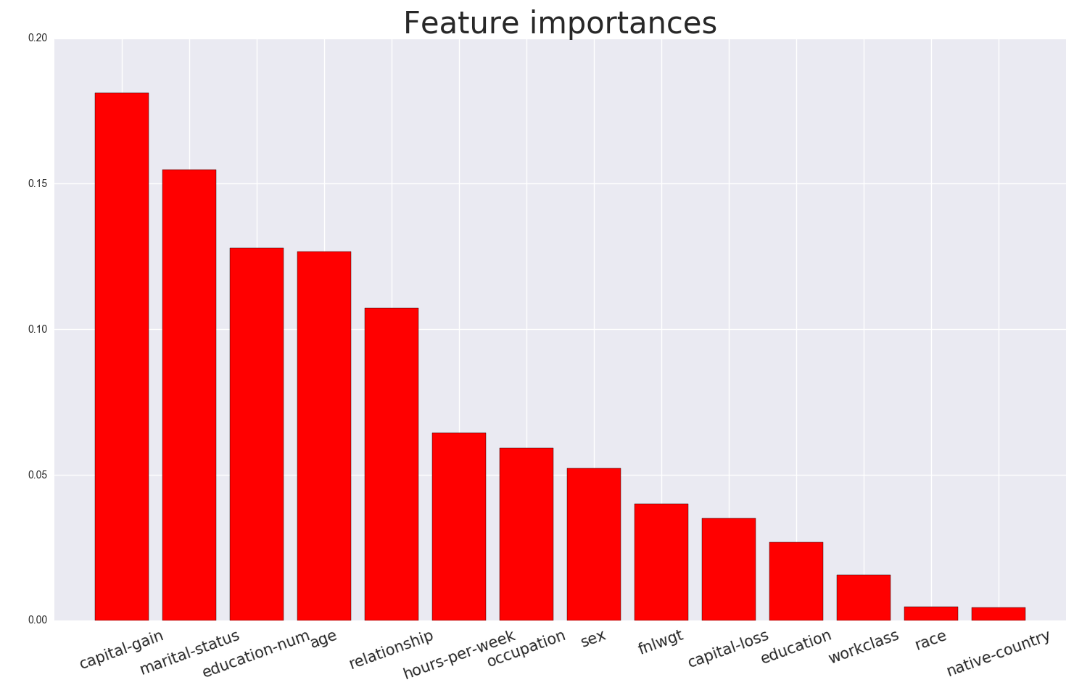
Importance Rank of Features Found in Grid Search in Random Forest

Slide 17
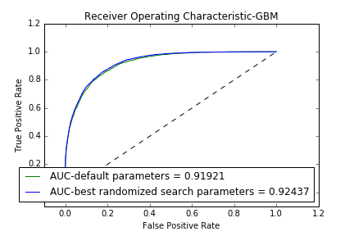
AUC Comparisons in GBM

Slide 18
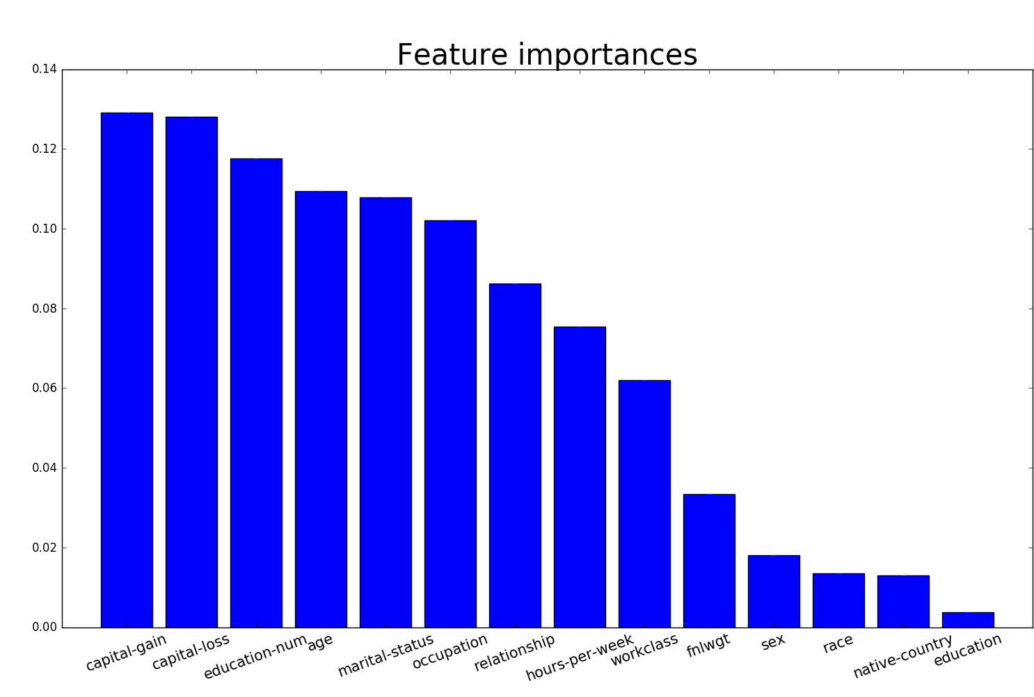
Importance Rank of Features Found in GBM

Slide 19
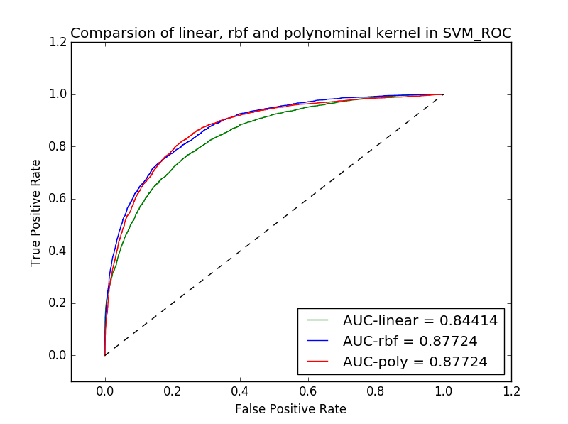
Comparison Linear and Non-linear Kernel in SVM Using Default Parameters

Slide 20
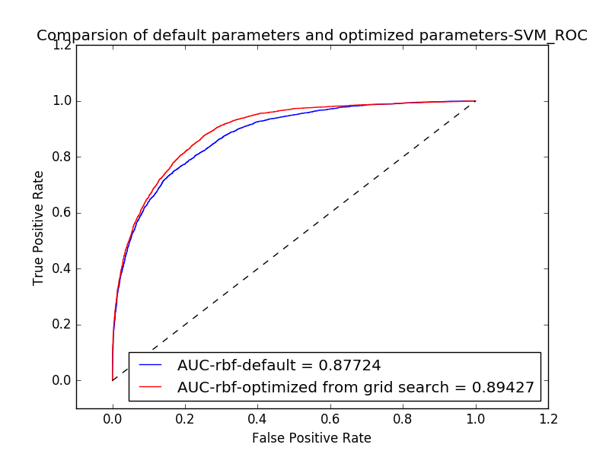
Comparison Default and Optimized Parameters -SVM

Slide 21
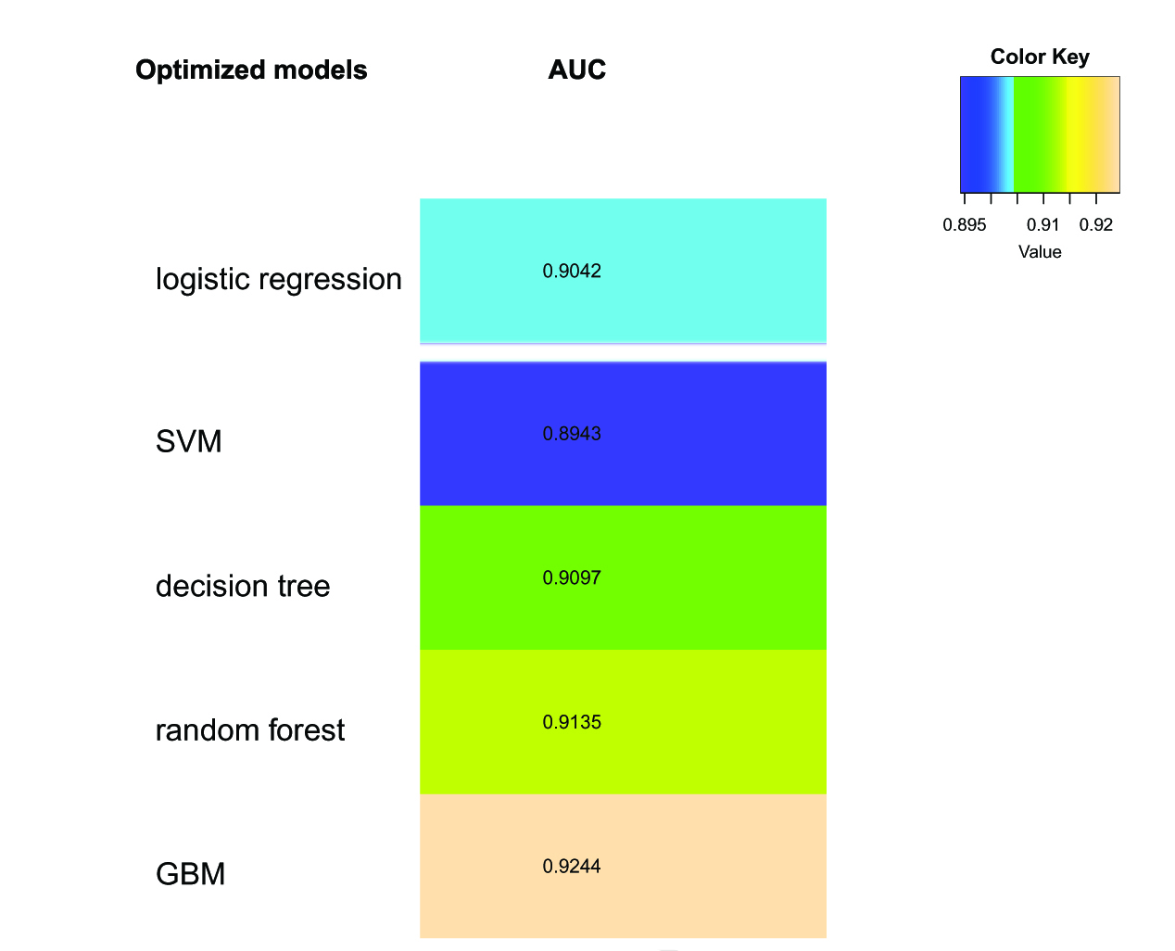
AUC Comparison of Optimized Models

Slide 22
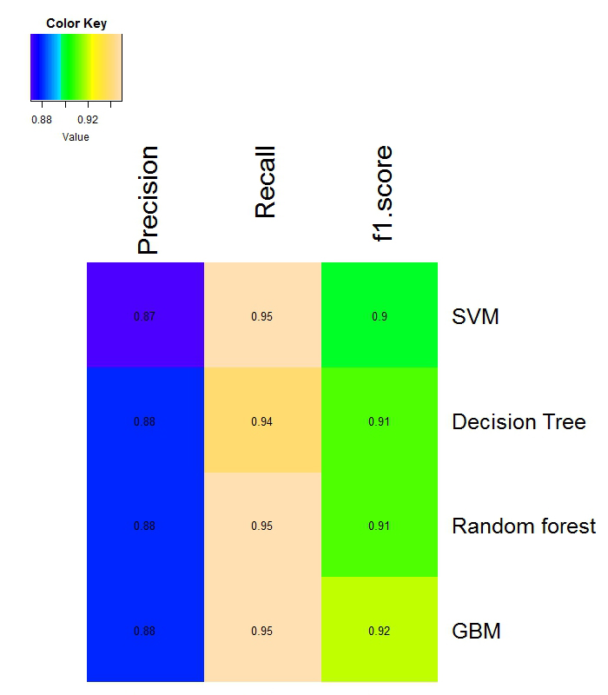
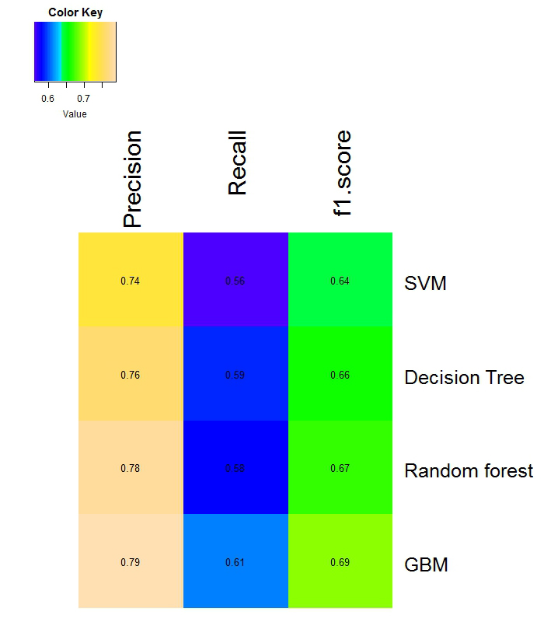
Confusion Matrix Comparison on Optimized Models
Performance on predication of =<50K
>50K

Slide 23
Conclusions
AUC and confusion matrix both showed that optimized GBM model has the best performance in all models built in this project on this dataset.
We can do importance rank of features in GBM and random forest models. Both models showed capital gain is the most important feature to determine income level.

